Slide 1
Report on Walmart Sales Analysis
Prepared by Shakil Ahammed

Slide 2
Overview
The Walmart Sales Analysis SQL Project aims to analyze and interpret the sales data of Walmart, one of the largest retail chains in the world. The project utilizes SQL (Structured Query Language) to query and manage large datasets, providing a comprehensive view of sales patterns, customer behavior, and inventory management. The analysis is focused on identifying key trends, performance metrics, and potential areas for optimization.

Slide 3
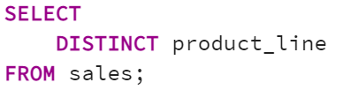
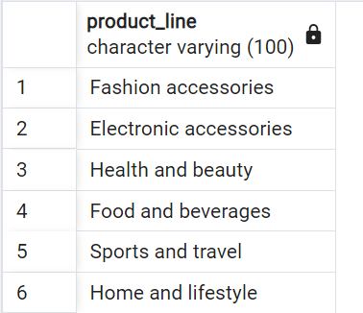
1. How many unique product lines does the data have?

Slide 4
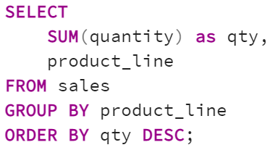
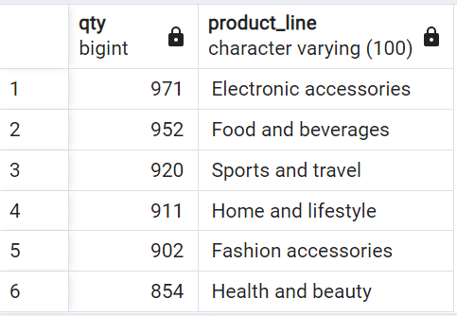
2. What is the most selling product line?

Slide 5
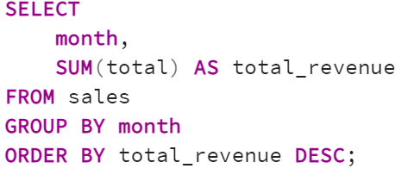
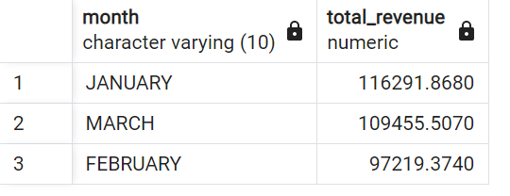
3. What is the total revenue by month?

Slide 6
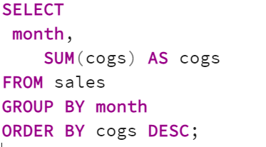
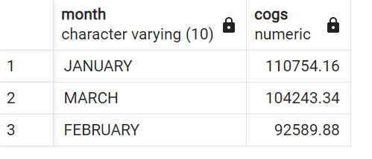
4. What month had the largest COGS?

Slide 7
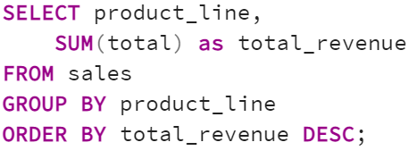
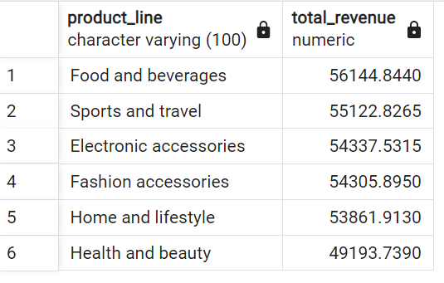
5. What product line had the largest revenue?

Slide 8
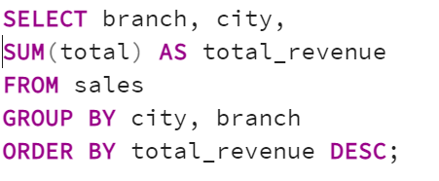
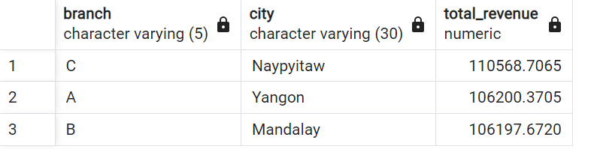
6. What is the city with the largest revenue?

Slide 9
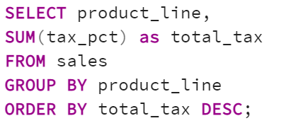
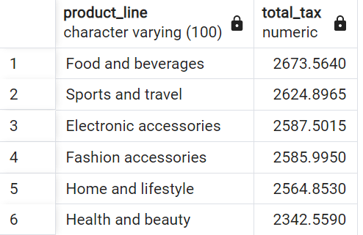
7. What product line had the largest VAT?

Slide 10
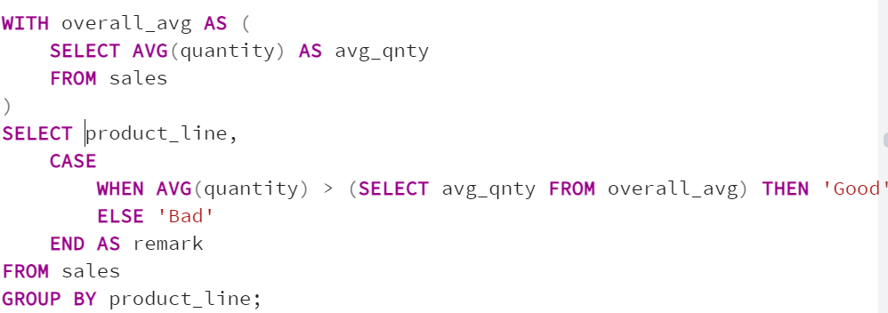
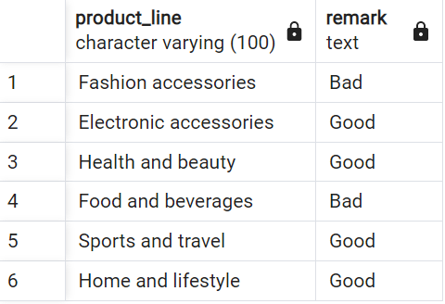
8. Fetch each product line and add a column to those product
line showing "Good", "Bad". Good if its greater than average sales?

Slide 11
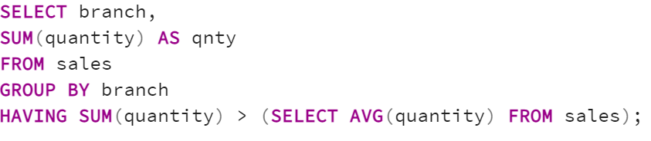
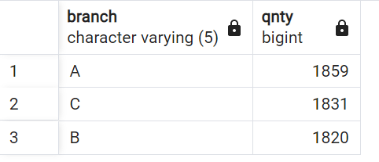
9. Which branch sold more products than average product sold?

Slide 12
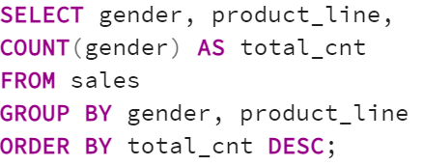
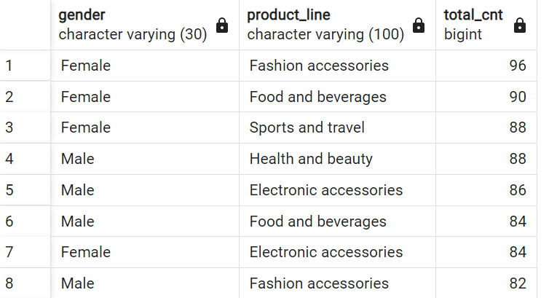
10. What is the most common product line by gender?

Slide 13
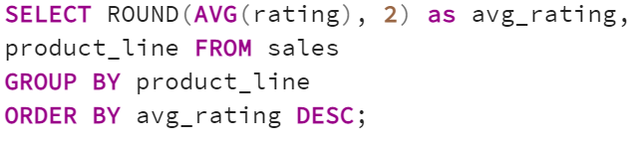
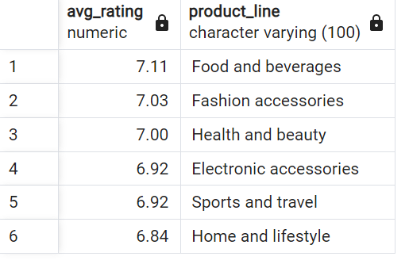
11. What is the average rating of each product line?

Slide 14
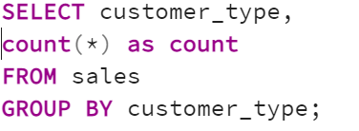
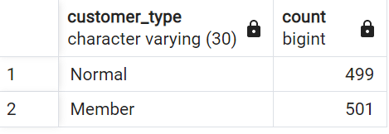
12. What is the most common customer type?/
Which customer type buys the most?

Slide 15
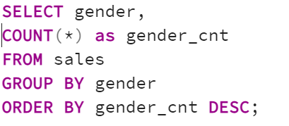
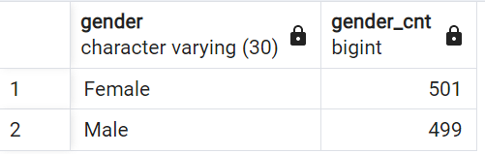
13. What is the gender of most of the customers?

Slide 16
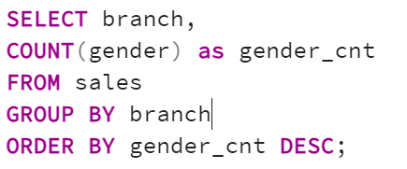
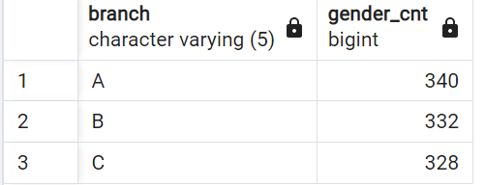
14. What is the gender distribution per branch?

Slide 17
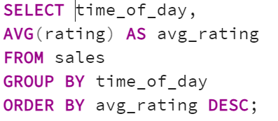
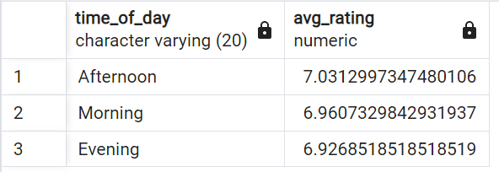
15. Gender per branch is more or less the same hence, I don't think has an effect of the sales per branch and other factors. Which time of the day do customers give most ratings?

Slide 18
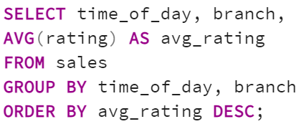
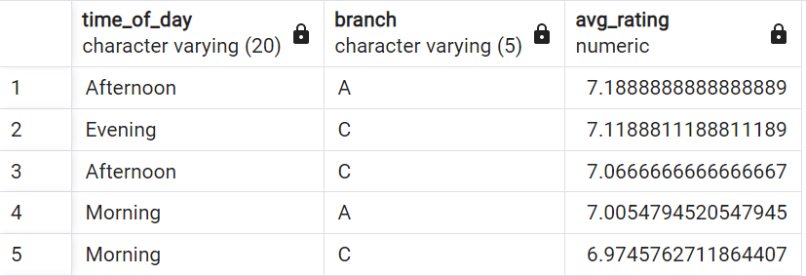
16. Looks like time of the day does not really affect the rating, its more or less the same rating each time of the day. Which time of the day do customers give most ratings per branch?

Slide 19
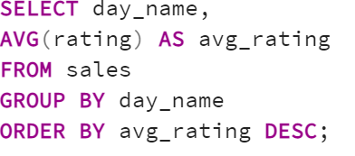
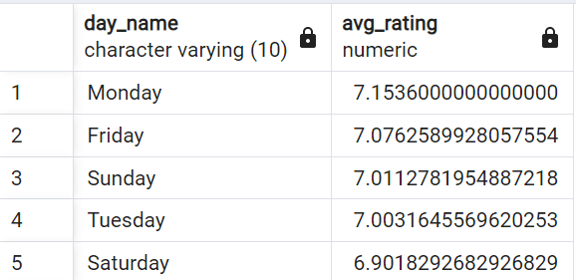
17. Branch A and C are doing well in ratings, branch B needs to do a
little more to get better ratings. Which day of the week has the best avg ratings?

Slide 20
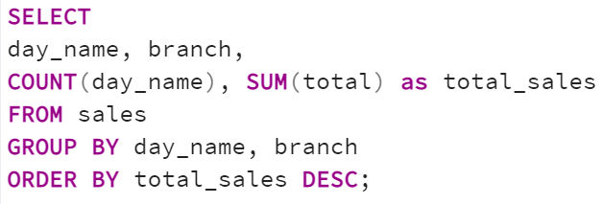
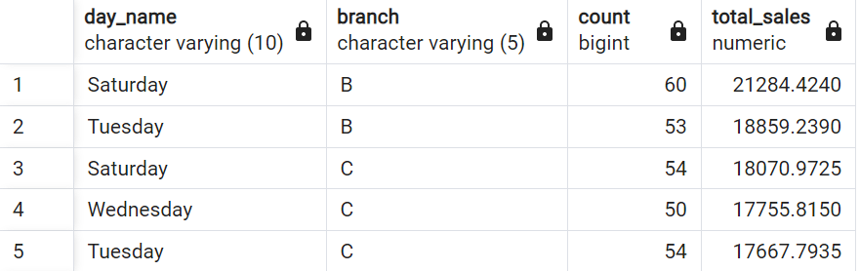
18. Monday, Friday and Sunday are the top best days for good ratings why is that the case, how many sales are made on these days? Which day of the week has the best average ratings per branch?

Slide 21
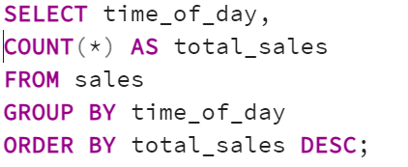
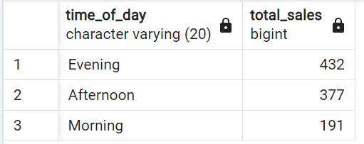
19. Number of sales made in each time of the day per weekday?

Slide 22
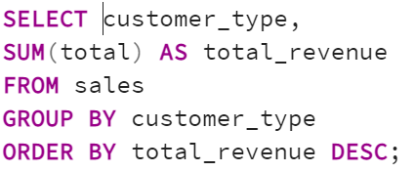
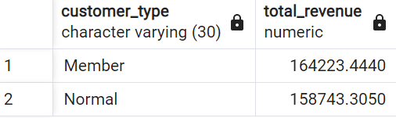
20. Evenings experience most sales, the stores are filled during the evening hours. Which of the customer types brings the most revenue?

Slide 23
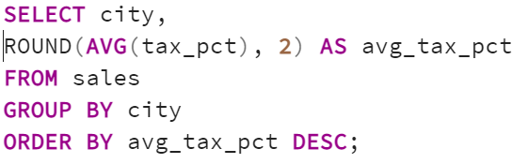
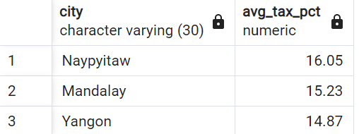
21. Which city has the largest tax/VAT percent?

Slide 24
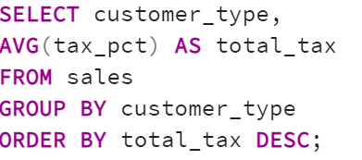
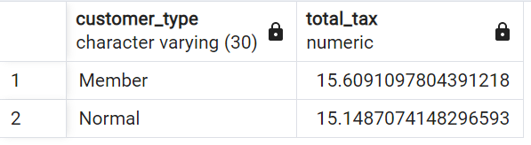
22. Which customer type pays the most in VAT?

